Slide 1
Proof Geometry
5-1: The Idea of Congruence
5-2: Congruences Between Triangles

Slide 2
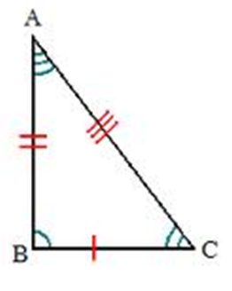
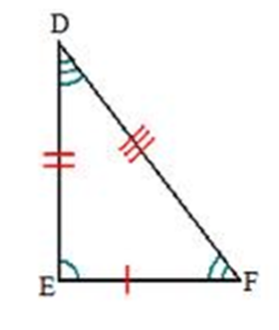
Congruence
Same size
Same shape

Slide 3
Two shapes are congruent if any or all of the following are true…
You can pick one up and move it onto the other (translation)
You can flip one over onto the other (reflection)
You can rotate one onto the other (rotation)

Slide 4
Translation

Slide 5
Reflection

Slide 6
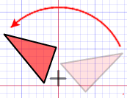
Rotation

Slide 7
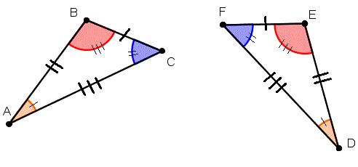
Correspondence
Two polygons are congruent when we can create a one-to-one correspondence between them. (Match each vertex)
We can write the correspondence as ABC ↔ DEF
The order of the second polygon’s name is determined by the order of the first.

Slide 8
Angles and Segments
Two angles are congruent if they have the same measure. $∠ABC≅∠DEF$
Two segments are congruent if they have the same length. $\overline{AB}≅\overline{CD}$

Slide 9
Triangles
Two triangles are congruent if all corresponding sides AND all corresponding angles are congruent.
ABC ←→ DEF, so we write $ΔABC≅ΔDEF$
Why is $ΔABC≅ΔDFE$ incorrect?
↔

Slide 10

Definitions…
Included Side: A side of a triangle is included by the angles whose vertices are the segment’s endpoints. $\overline{AB} is included by ∠A and ∠B$
Included Angle: An angle is included by the sides of the triangle which lie on the sides of the angle. $∠A is included by \overline{AC} and \overline{AB}$

Slide 11
More equivalence relations (these are Theorems)
Congruence for segments is an equivalence relation.
Congruence for triangles is an equivalence relation.

Slide 12
HOMEWORK
Pg. 126-129: # 2,6,7,12
Pg. 134-135: # 1, 2, 4-6, 8, 12, 13

