Slide 1
17f: The Cosine Ferris Wheel
Modeling with Trigonometry

Slide 2
Matching 1: Functions
Take turns to match and place cards the best you can.
Be sure to explain how you came to your decision.
Your partner should either explain that reasoning again in his or her own words, or challenge the reasons you gave.
You both need to be able to agree on and explain the placement of every card.
If you cannot find a card to match, then make one up yourself.

Slide 3
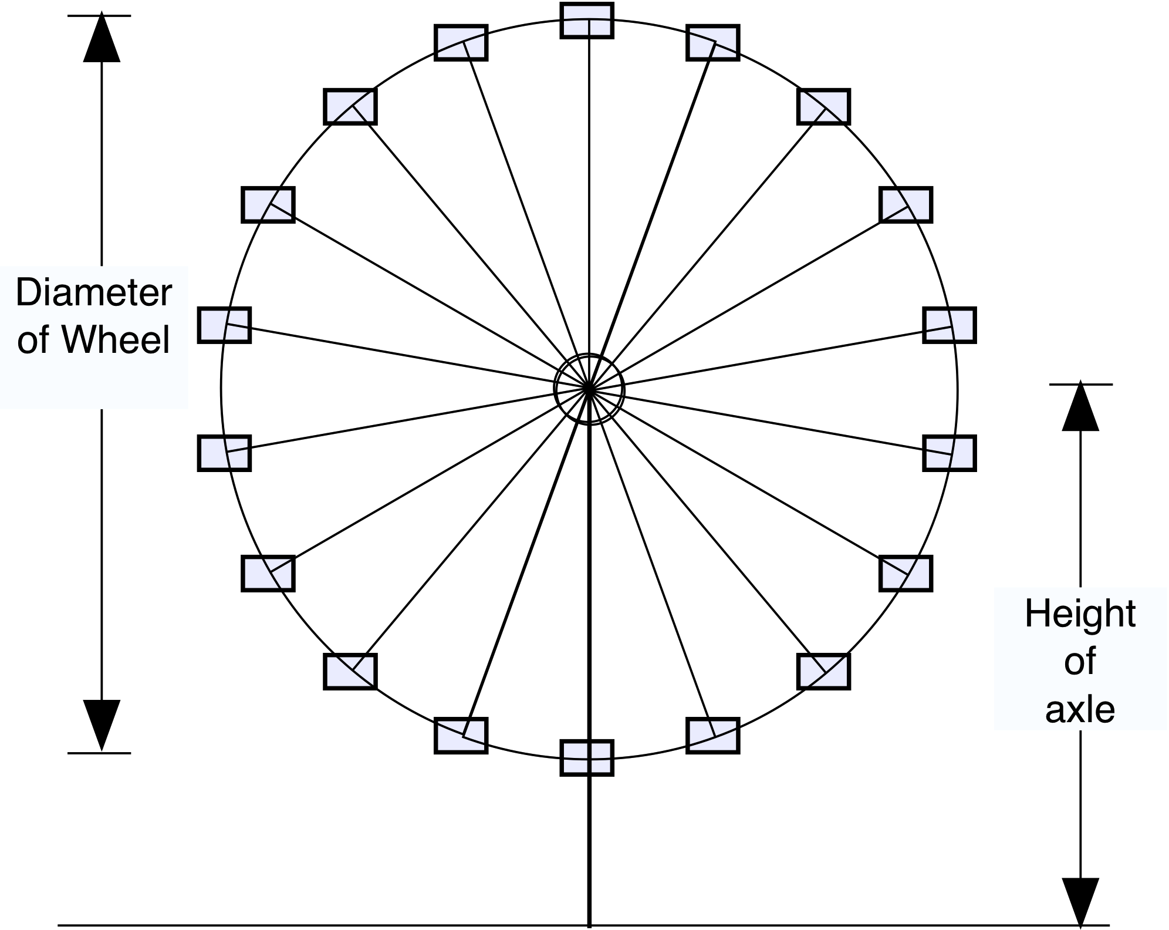
Matching 2: Descriptions

Slide 4
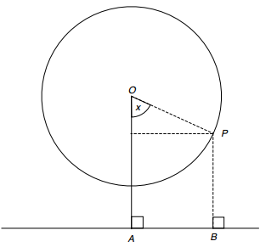
Analyzing the Ferris Wheel
The diagram shows the position of a rider, P, at time, t.
Height of the axle = OA = a
Radius of the wheel = OP = b
∠POA = x
As P goes round, then x = ct for some constant c. c=360/period
Height of the rider = PB = OA + –OP*cos(x)
So h = a + –b*cos(ct)

Slide 5
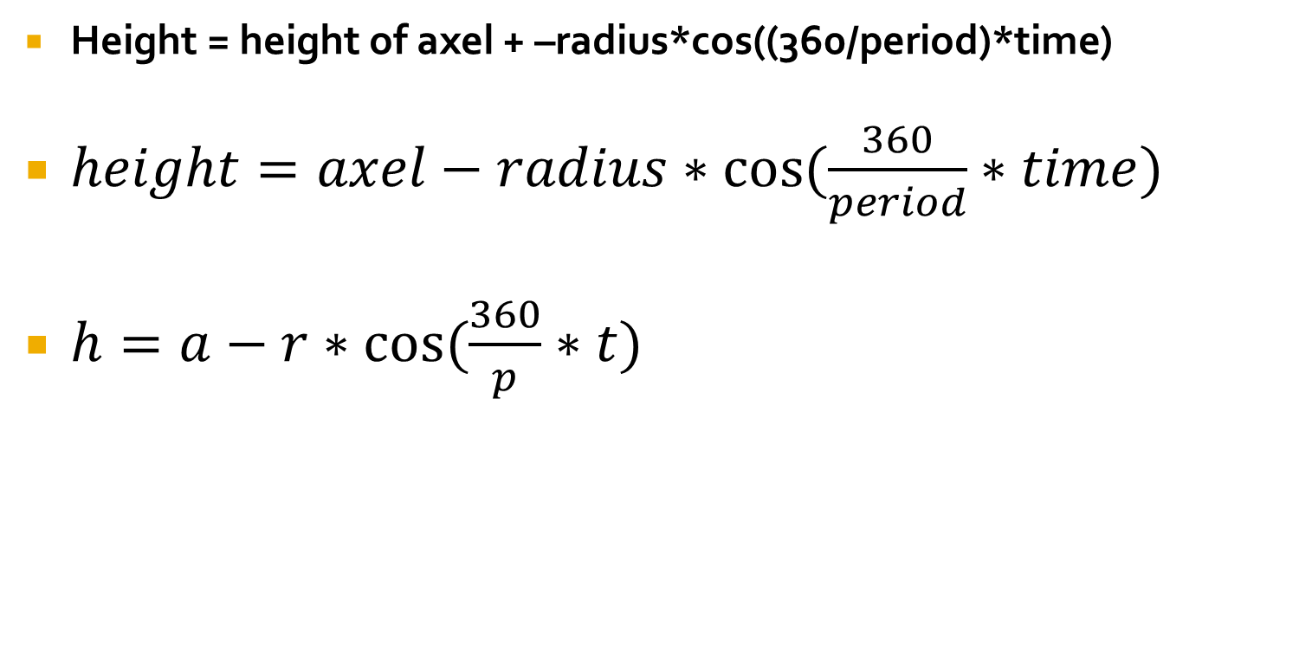
Bringing it all together.
Height = height of axel + –radius*cos((360/period)*time)
$height=axel−radius∗cos⁡(\frac{360}{period}∗time)$
$h=a−r∗cos⁡(\frac{360}{p}∗t)$

