Slide 1
7–8 Altitudes of Triangles
Proof Geometry

Slide 2
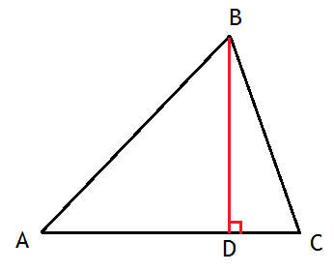
Altitude of a triangle
The altitude of a triangle is a perpendicular segment from a vertex of the triangle to the line containing the opposite side.
We also refer to the line containing the altitude as the altitude

Slide 3
Sketch the altitudes for each Triangle

Slide 4
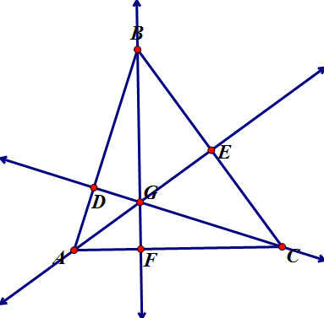
Prove that the perimeter of ΔABC is greater than the sum of its altitudes.
Based on the First Minimum Theorem:
BF < AB
AE < AC
CD < BC
BF+AE+CD < AB+AC+BC [add prop ineq]
Sum of Altitudes < Perimeter

Slide 5
Homework
p. 237-239: #1-5, 10-12.

