Slide 1
4-9 Writing Up Proofs
Proof Geometry

Slide 2
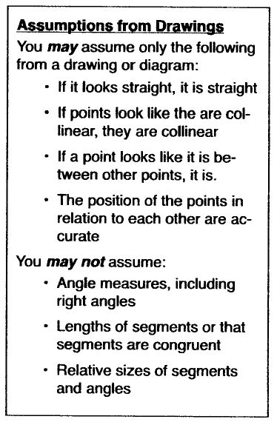

Slide 3
Proof Tips
Copy the figure as well as the full ‘Given’ and ‘Prove’.
Use the two column format to write the proof.
Neatness often helps you thinking more clearly.

Slide 4
Proof Tips
Derive your statements and reasons from the:
Given
Figure
Previous steps
Definitions
Postulates
Previous proven theorems

Slide 5
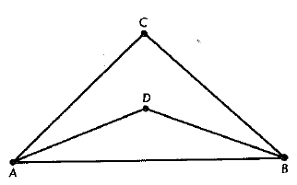
Example 1
Statements | Reasons
∠DAB ≅ ∠DBA | Given
m∠DAB = m∠DBA | Def. of congruent angles
∠CAD ≅ ∠CBD | Given
m∠CAD = m∠CBD | Def. of congruent angles
m∠DAB + m∠CAD = m∠DBA + m∠CBD | Addition prop. of eq.
m∠DAB + m∠CAD = m∠CAB | Angle Addition Postulate
m∠DBA + m∠CBD = m∠CBA | Angle Addition Postulate
m∠CAB = m∠CBA | Substitute 6 and 7 into 5
∠CAB ≅ ∠CBA | Def. of congruent angles
Q.E.D.

Slide 6
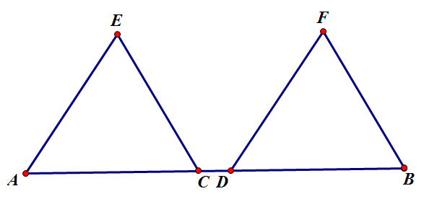
Example 2
Given: AD = CB
Prove: AC = DB
Statements | Reasons
AD = CB | Given
AC + CD = AD | Def. of between
CD + DB = CB | Def. of between
AC + CD = CD + DB | Substitute 2 and 3 into 1
AC = DB | Subtraction prop. of eq.
Q.E.D.

Slide 7
Homework
pg. 112-115: #8, 10, 12, 13, 16, 17, 18
If you feel that you need more practice, solutions to 11 and 15 are in the back of the book.

