Slide 1
17c: The “other” trig functions
Secant, Cosecant, Cotangent.

Slide 2

Relationships we will prove later
Secant (sec)
$\sec{θ=\frac{1}{cosθ}}$
Cosecant (csc)
$\csc{θ=\frac{1}{sinθ}}$
Cotangent (cot)
$\cot{θ=\frac{1}{tanθ}}$

Slide 3
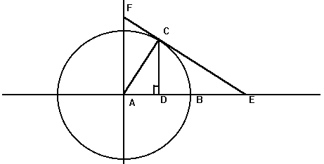
Where are they?

Slide 4
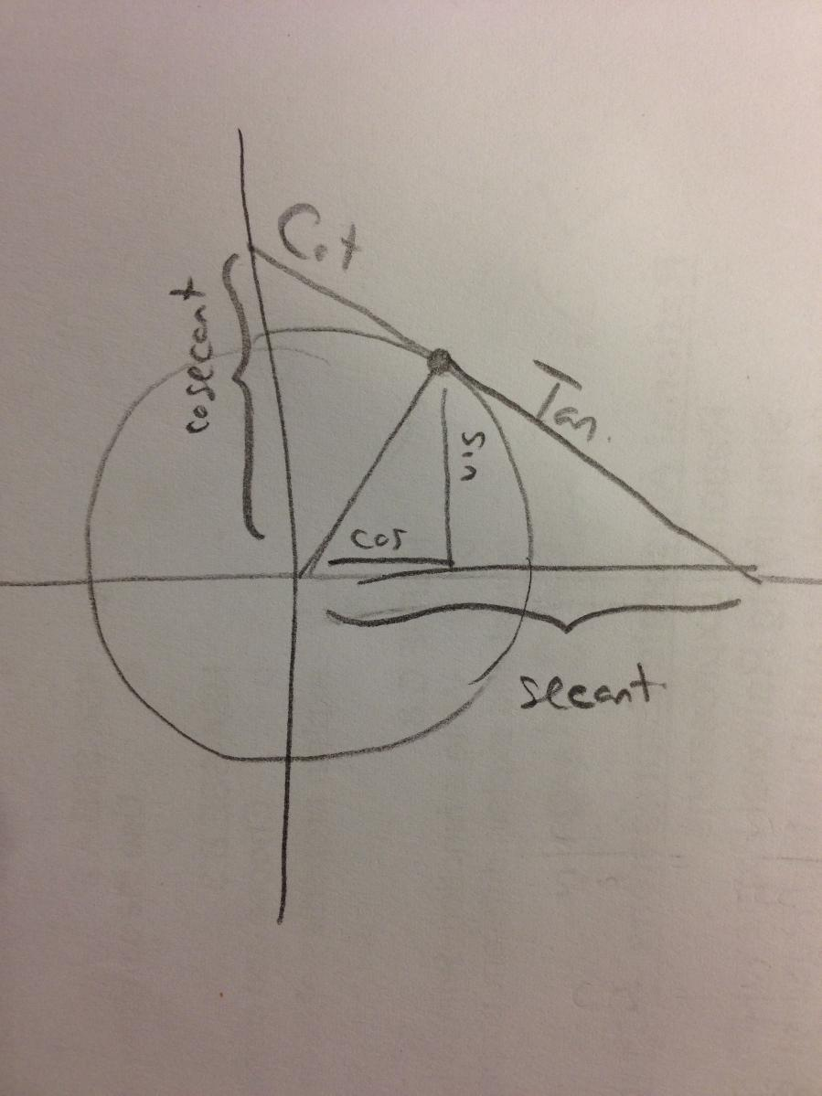
Answer Key:

Slide 5
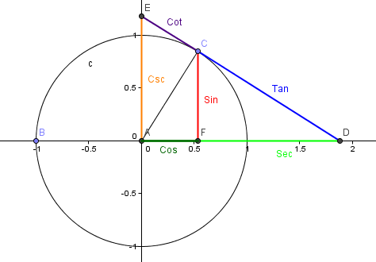
Answer Key: Geogebra

Slide 6
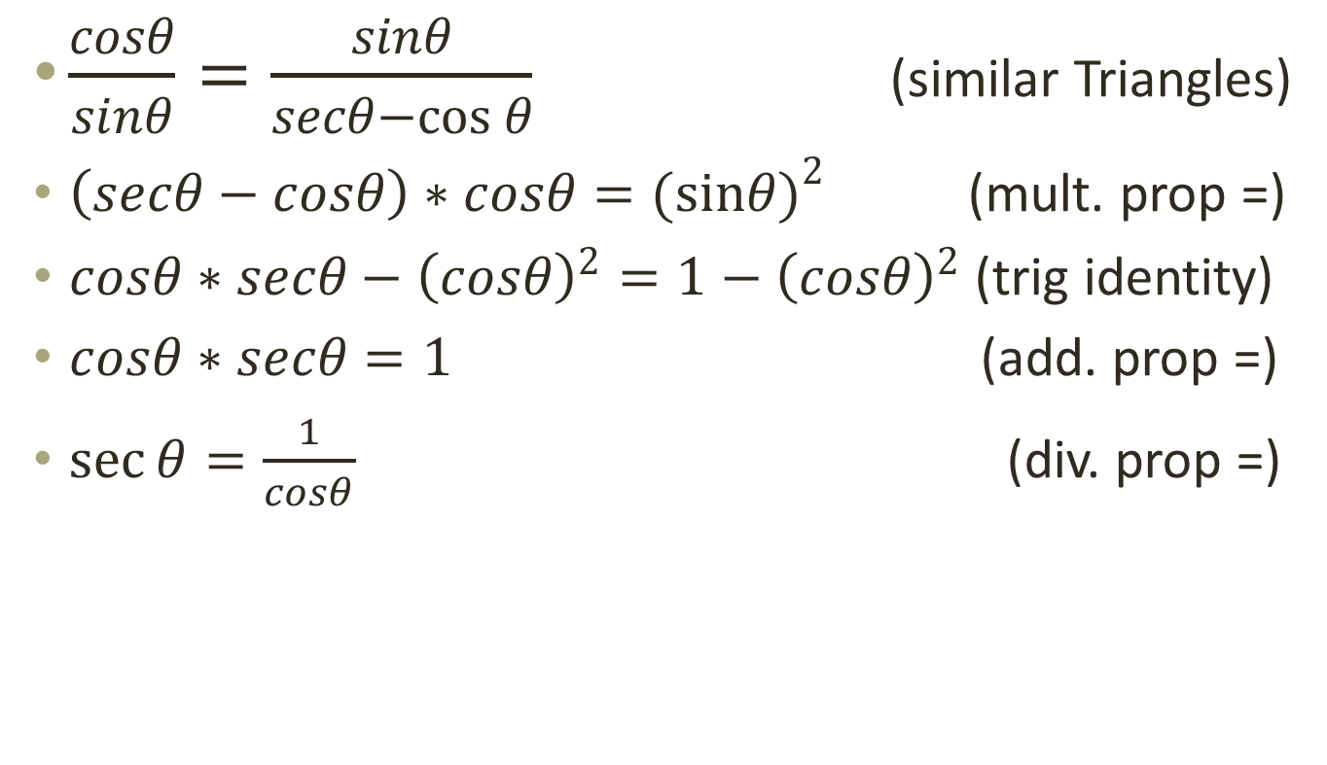
Prove: $\sec{θ=\frac{1}{cosθ}}$
$\frac{cosθ}{sinθ}=\frac{sinθ}{secθ−\cos{θ}}$ (similar Triangles)
$\left(secθ−cosθ\right)∗cosθ=(sin{θ)}^{2}$ (mult. prop =)
$cosθ∗secθ−{\left(cosθ\right)}^{2}=1−{\left(cosθ\right)}^{2}$ (trig identity)
$cosθ∗secθ=1$ (add. prop =)
$\sec{θ=\frac{1}{cosθ}}$ (div. prop =)

Slide 7
Prove: $\csc{θ=\frac{1}{sinθ}}$
Csc/sec = sin/(sec-cos) (similar triangles)
(sec-cos)(csc/sec) = sin (mult. Prop =)
(sec-cos)csc = sin*sec (mult. Prop =)
(1/cos-cos)(csc) = (1/cos)(sin) (sec = 1/cos)
(1-cos^2)(csc) = sin (mult. By cos)
(sin^2)*(csc) = sin (trig identity sin^2 + cos^2 = 1)
Csc = 1/sin (div prop =)

Slide 8
Prove: $\cot{θ=\frac{1}{tanθ}}$
Cot/csc = sin/tan
Sin*cot = sin/tan
Cot = 1/tan

