Slide 1
These be the directions eh.

Slide 2
Follow these here steps:
Make sure you have a sharpened pencil. Write your name and date.
Inside this large rectangular border, draw a blob — yes, blob — with an area that’s approximately 1/5 of the rectangle’s area. No one will die if it’s not quite 1/5.
Next, draw a dot anywhere inside the rectangle but outside the blob. Label this dot H.
Now, draw another dot — but listen carefully! — so that there’s no direct path from this dot to the first dot H. Label this second dot B.

Slide 3
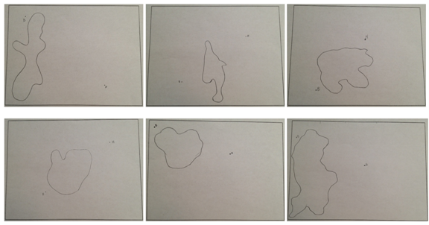
Kind of like these:

Slide 4
Miniature Golf Course!
Blob = water
Point B = Golf Ball
Point H = Hole
Find the path the ball needs to take to make a hole in one! (you may use a ruler, not a protractor)

