Slide 1
10h Creating Equations From Patterns

Slide 2
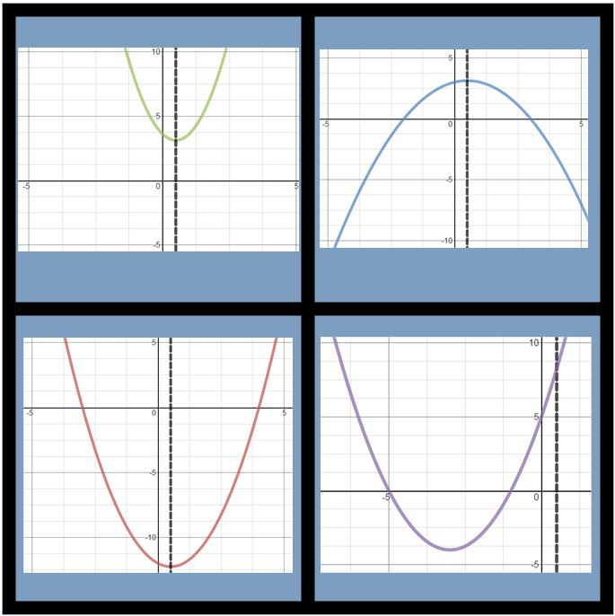

Slide 3
